Slide 1
Taxonomy 2.0
Formalizing Knowledge Engineering to improve meaning, integration, and enable interoperability

Slide 2
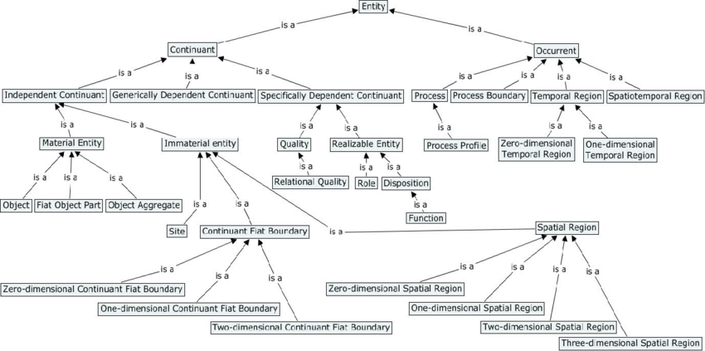
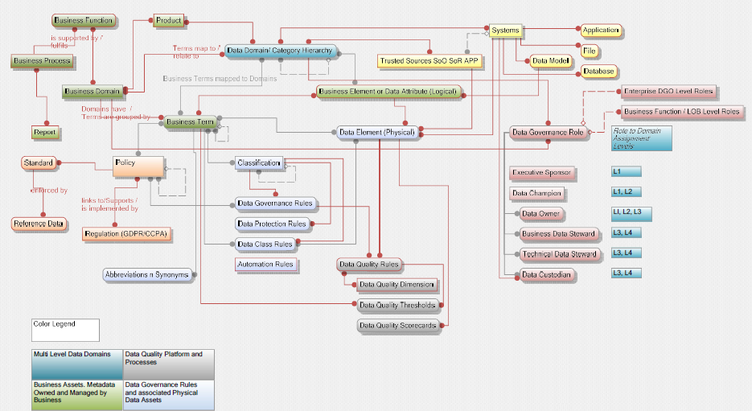
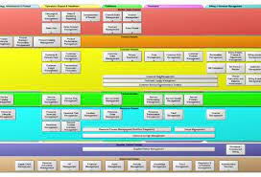
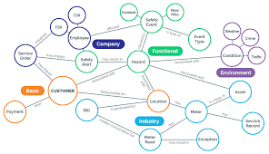
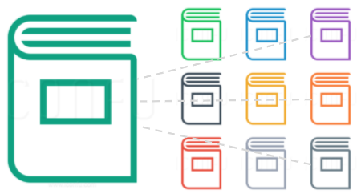

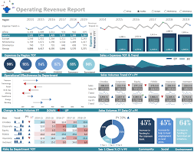
HL Future State for VZ Taxonomies & Ontologies
Semaphore
Leverage our investment in MarkLogic to harmonize taxonomies for DG (MM), Telecom (SID), Finance (COA), Asset Mgmt (many), HR (Org Structure), etc.
Establish a KG for Data Governance so we can instantiate values for lookups to support UX, Operational Parms in scripts & components across the Digital Supply Chain.
Create KGs for Consumer & Network to support Data Products (Customer 360, Digital Twins) using component-based ontologies (including location, identity, party, device, account, …)
BFO
Upper Ontology
Taxonomies
Semantic Extensions
Search (L1-L5)
VZ MM
SID
MarkLogic
Search (Augmented & Complex)
KGs (Domain Specific)
Instances (values)
  used for lookups
KG DG
KG GTS
KG FIN
VDIL
Marketplace
Services
User Onboarding
Order (Subscribe)
Order (Test Data)
Consumer Portfolios
Community Portals
Operational Insights
Verizon
Data Catalog
Search & Discover
Protect
Dashboards

Slide 3
Benefits of Adopting the BFO Upper Ontology
Knowledge Management (Meaning at Scale)
Interoperability: BFO provides a common language for different ontologies, allowing for easier integration and interoperability between ontologies.
Consistency: BFO's upper ontology is designed to be consistent and coherent, providing a framework for ensuring consistency in ontologies that use it.
Clarity: BFO's upper ontology is designed to be intuitive and easy to understand, making it easier for ontology developers to use and for users to understand.
Extensibility: BFO is designed to be extensible, allowing developers to add new concepts and relationships to the ontology without compromising its consistency or coherence.
Domain independence: BFO's upper ontology is domain-independent, meaning it can be used across different domains and applications. This makes it a useful tool for ontology development in a wide range of fields, from medicine to finance to engineering.
Semaphore
BFO
VZ MM
SID
Short list of taxonomies already in place but not formally managed and harmonized under an upper ontology:
Chart of accounts
Organizational structure
Account structure
Location
Products & Services
Data Assets
Policies
Analytic Assets (metrics, reports, calcs)
Model Registry.
IT Assets (hardware, software, networks)
Customers
Vendors
Processes

Slide 4
Data Supply Chain
Outcome Driven Value
Outcome Driven Services
Knowledge
(Taxonomies & Metamodel)
Capability Map
Inventory Management
Order Management
Supplier Engagement
Connect
Secure & Protect
Search & Discover
Order
Entry
Order Fulfillment
Order Delivery
Ingest
Profile, Classify, & Enrich
Publish & Catalog
Platform Management
Policy Management
Integration & Workflow
Scheduling & Capacity Planning
Privacy
Security
Compute & Memory
Storage & Persistence
WKC Platform
Sharing
Protection
Operations Management
Quality Profiling
Monitoring & Measurement
Triage & Support
Outcome Focus
Outcome Driven Delivery (Products & Services) | Communicate - Collaborate - Coordinate
Notes:
04-16-23 JW
Here’s a progressive roadmap to achieve the 2026 Northstar applying tactical steps to extend our investment in the Digital Supply Chain for Maap
2023 1H - Introduce Inventory Management
Supplier Management
Material Ingestion (Schedule & Optimize)
Inventory Identification & Classification, & Enrichment
Inventory Cataloging & Profiling
2023 2H - Introduce Order Management
Order Entry (Search, Subscribe, Request TD)
Order Optimization (Scheduling, Prioritizing Capacity with Demand)
Order Fulfillment (Extracting & Transforming, Profiling & Synthesizing)
Order Delivery (Packaging & Bundling, Virtualizing & Deploying)
2024 1H - Grow Inventory Management
Formalize Knowledge Engineering (meaning at scale)
Expand Inventory Management (OLTP, OLAP, DG&A Operational Data)
Extend Inventory Management (Quality Profiling, Projection, & Limited Cleansing)
Extend Supplier Management & Ingestion Pipelines into Lifecycles for Applications & Warehouses
2024 2H - Grow Order Management
Extend Context to all Inventory (mapping metadata to Component Ontologies)
Extend Order Entry (Contextualize & Tailor Customer Experience)
Extend Order Entry (Augmented & Semantic Search)
Build Trusted Analytic Services using Cataloged Calcs & Data Assets
Build Adaptable Policy Controls for Data, Analytics, and Algorithms
2025 1H - Mature Inventory Management
Industrialize Knowledge Engineering
Optimize Trust by Expanding Data Cleansing
Optimize Quality Profiling for Data Assets & Data Products
Expand Data Project (Impact Analysis for downstream consumers)
Build Adaptable Data Pipelines using VZ Data Integration Layer
Build Lineage & Visibility across Material Acquisition through Inventory Control & Order Management
Data Assets, Data Products, Data Analytics, Data Algorithms (AI Models)
2025 2H - Mature Order Management
Reduce Operating Costs & Inefficiencies (manual effort, cycle time)
Improve Data Literacy by extending Data Contextualization (Taxonomies & Ontologies)
Improve Resilience & Adaptability across Order Management (model driven change vs. code & configuration)

Slide 5
Supporting Materials

Slide 6
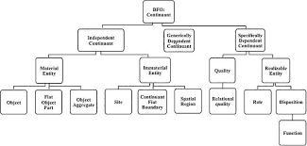


How can a Telecom Leverage an Upper Ontology?
An Upper Ontology can be used to harmonize multiple taxonomies, as it provides a common framework for defining and classifying entities and relationships that can be used across different taxonomies. BFO's upper ontology provides a set of foundational concepts and relationships that can be used to define more specific concepts and relationships in different taxonomies.
By adopting BFO as a common framework, different taxonomies can be mapped and aligned to ensure consistency and interoperability between them. For example, a company with multiple business units or departments may have different taxonomies for product classification, customer segmentation, and sales channels.
By mapping these taxonomies to BFO's upper ontology, the company can ensure that each taxonomy uses the same foundational concepts and relationships, and that these concepts and relationships are consistent across different taxonomies.
Chart of Accounts
Policies (Terms)
Org Chart
Data Products
Products
Services
Customers
Locations

Slide 7





















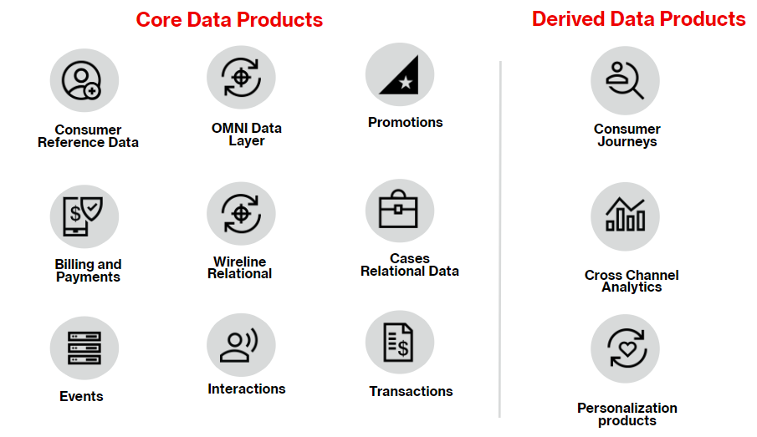
Benefits of Adopting an Upper Ontology for Data Products
Data Product
Consistent Data Representation: BFO provides a standardized framework for representing concepts and relationships so we can ensure consistent data representation across different systems, departments, and data sources. This promotes data integrity and coherence, enabling accurate and meaningful analysis.
Enhanced Data Integration: Harmonizing taxonomies using BFO facilitates the integration of diverse data sources so we can establish a common language and semantic structure for data integration, enabling seamless merging and analysis of consumer data from various sources. This leads to a more comprehensive understanding of customer behavior and preferences.
Improved Cross-Domain Analysis: BFO's upper ontology allows for cross-domain analysis by providing a shared vocabulary and framework so we can bridge different data domains and perform multi-dimensional analysis, uncovering correlations and insights that span various aspects such as customer demographics, usage patterns, marketing campaigns, and network performance.
Actionable Insights and Decision-Making: Harmonizing taxonomies using BFO enables the generation of actionable insights so we can derive meaningful relationships and patterns from consumer data. This empowers data-driven decision-making, enabling the identification of new revenue opportunities, improved customer targeting, and the optimization of marketing strategies.

Slide 8
Aligning Taxonomies using an Upper Ontology for our Taxonomies
Data Product
Customers and Consumers:
Customer demographics - map and align different customer demographic categories, such as age, gender, income, and location. This involves standardizing the classification schemes and creating a unified taxonomy that encompasses all relevant attributes.
Customer behavior - integrate and align various behavioral data sources, such as purchase history, website interactions, and customer engagement metrics. They can establish common event types, standardize metrics, and define consistent definitions for actions like "click," "view," or "purchase."
Operations:
Supply chain data - Mapping different product hierarchies, merging overlapping categories, and defining a consistent classification structure for efficient supply chain management.
Resource management - Standardizing job roles, defining a common set of skills or qualifications, and establishing a consistent hierarchy for resource allocation and planning.
Products and Services:
Product specifications - Create a common set of product attributes, defining attribute value ranges, and mapping similar attributes from different sources to ensure consistency in product descriptions and comparisons.
Service offerings - Mapping similar services, standardizing service levels, and establishing a unified structure for service packages and pricing.
Financial Planning:
Financial metrics - Defining consistent formulas, mapping similar metrics, and establishing a unified set of financial ratios for analysis and reporting.
Cost classifications - Standardizing cost classification schemes, mapping similar cost items, and creating a unified hierarchy for cost analysis and budgeting.

Slide 9
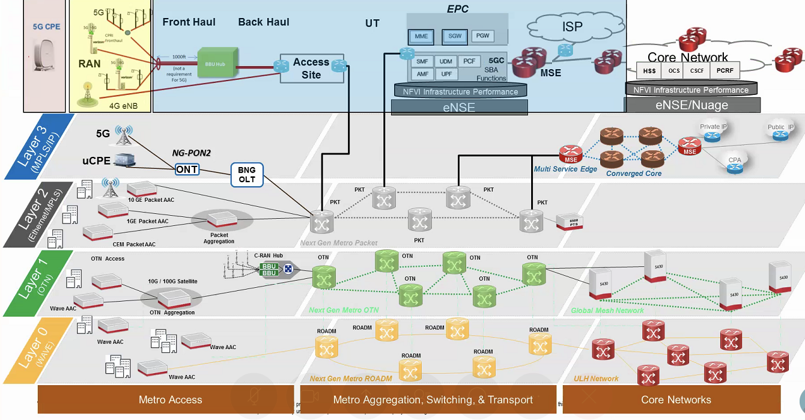
Can BFO help us with Design & Development of our Digital Twins?
There are already companies using the Basic Formal Ontology (BFO) to guide the design and development of their digital twins. BFO provides a framework for defining the foundational concepts and relationships that are used to represent entities and processes in a given domain, which is essential for building accurate and effective digital twins.
GE Digital has developed a software platform called Predix, which is used to create digital twins for industrial equipment. BFO is used as the foundational ontology for Predix, providing a common framework for defining and classifying entities and relationships within the industrial equipment domain.
Siemens Digital Industries Software, which offers a suite of software tools for creating and managing digital twins across various industries. Siemens uses BFO as a foundation for their ontology development, which allows for the integration of different domain-specific ontologies and taxonomies.
EU-funded project DigiTwin and the US National Institute of Standards and Technology's (NIST) Digital Thread for Smart Manufacturing Initiative are using BFO to guide the development of digital twins for manufacturing and other industries.

Slide 10
Suggested Next Steps
Setup a DEV sandbox within Semaphore
Introduce BFO’s upper ontology
Model the concepts we need to support the subjects and domains for our current Metamodel
Incorporate the concepts supporting the SID taxonomy
Use the concepts to map both taxonomies under BFO
Review areas of overlap and harmonization between both taxonomies
Incorporate concepts from the Privacy (PWC) ontology work
Build a taxonomy supporting our policy terms (used for DG covering OLAP AND OLTP)
Publish a next gen version of the VZ Taxonomy
Critical that we do not attempt a rip & replace in our current VZ Data Catalog w/o a careful assessment. Don’t want to disrupt Q2 work in progress, operations for Profiling & Classification. Cannot afford to jeopardize current state capabilities in our current catalog
Evolutionary NOT Revolutionary Approach

